Slide 1



CSC207 Final Project Presentation
Presented by Group #24
Alice Baker
Yue chen
Yuewen zhang
Zhikang Tian

Slide 2
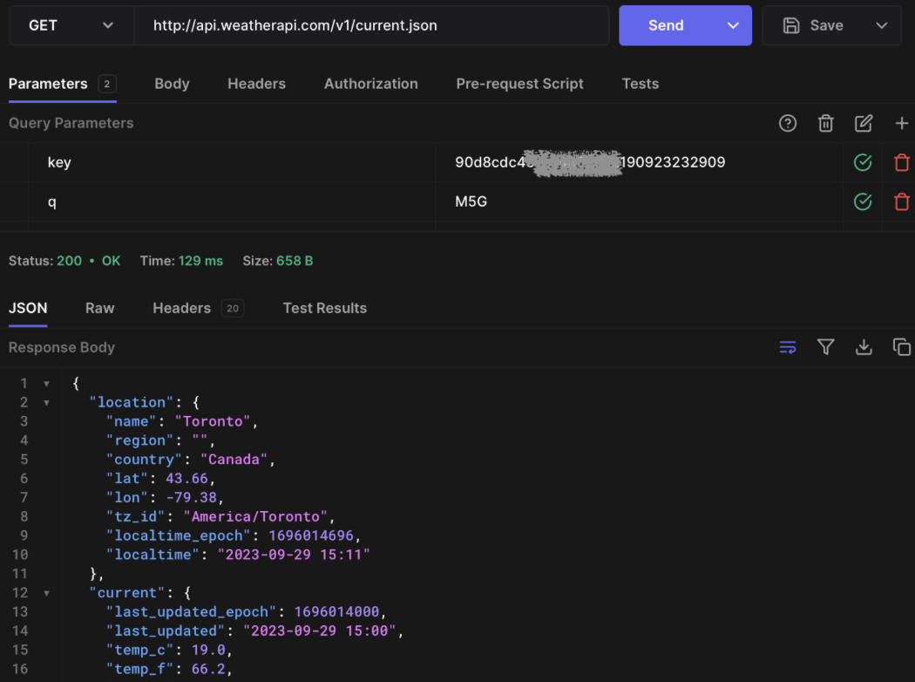

Weather api
Our Project has connected Weather API from weatherapi.com, which is an API can help us get detailed weather conditions based on the location we provide.
We have chosen this API as it is free for us to get information and easy to connect and parse.
An example screenshot from hoppscotch.io of GET from Weather API for location of Toronto.

Slide 3


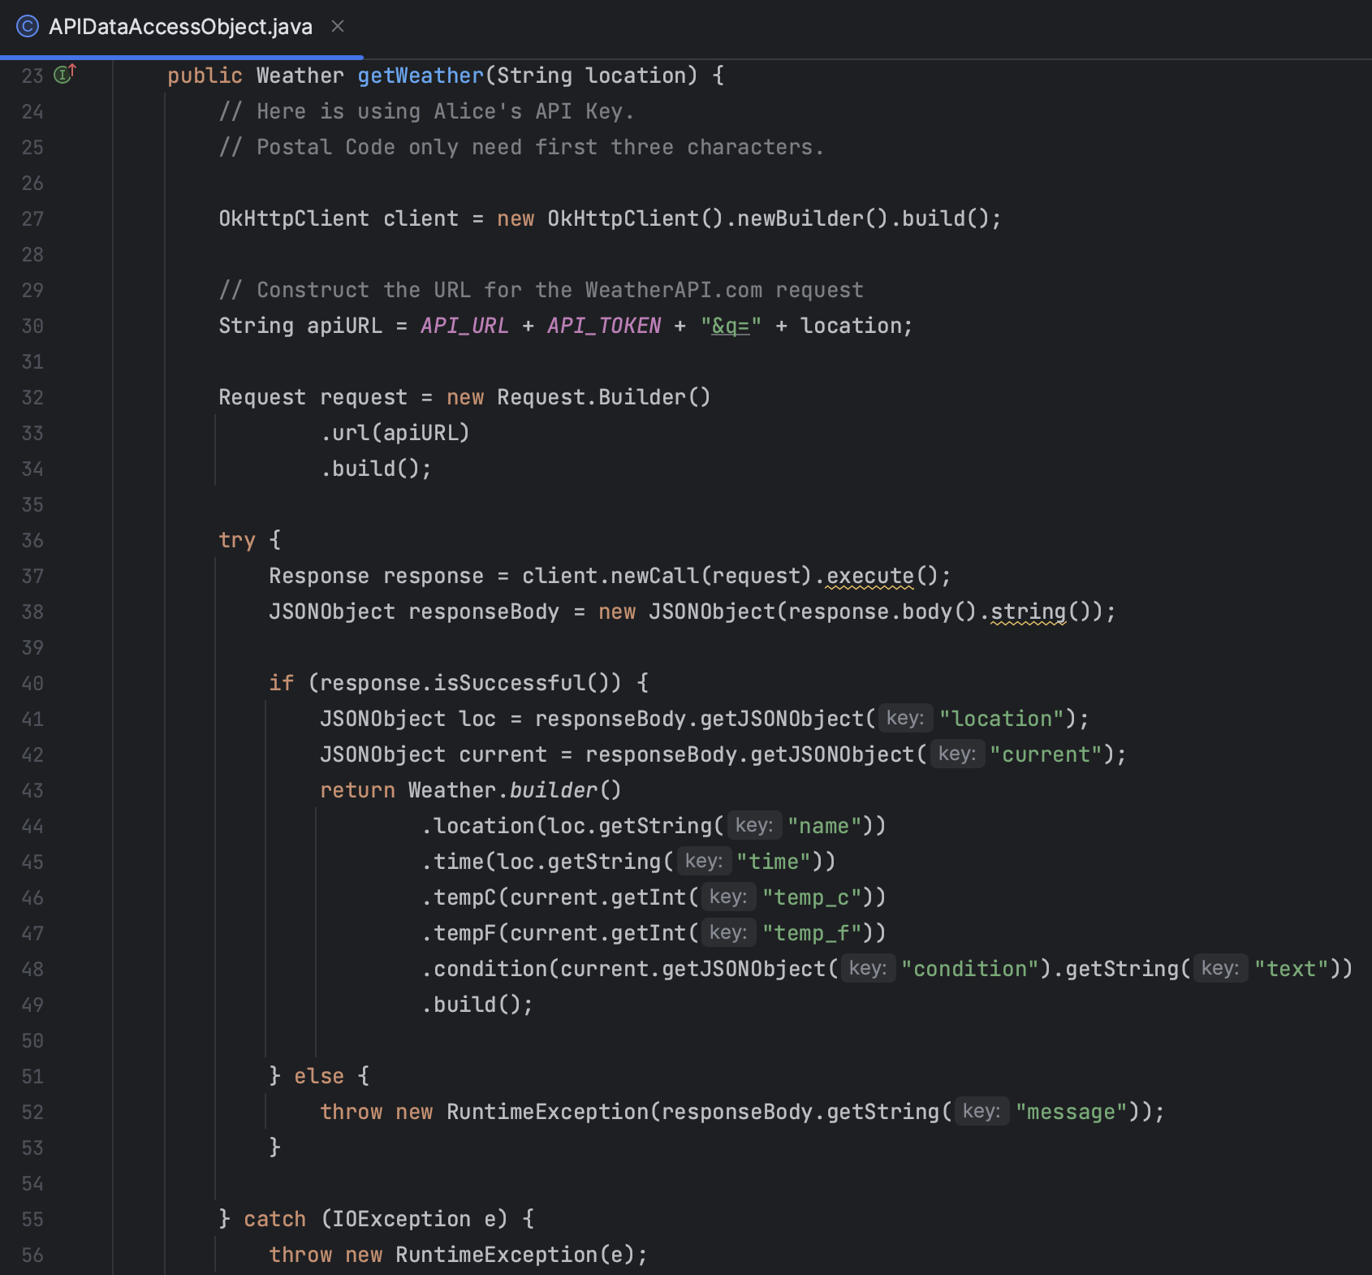
API Endpoint 1 Weather status
Description: This endpoint retrieves the current weather data for a specific location.
URL Structure: https://api.weatherapi.com/v1/current.json?key=[API_KEY]&q=[LOCATION]
Class Involved in our Project: APIDataAccessObject, Weather, Weather Use Cases and Weather Interface Adapters.
Method: getWeather(String location)
Functionality: When user requests the weather for a specific location, this endpoint is called. The response includes data such as temperature, conditions, and time.

Slide 4


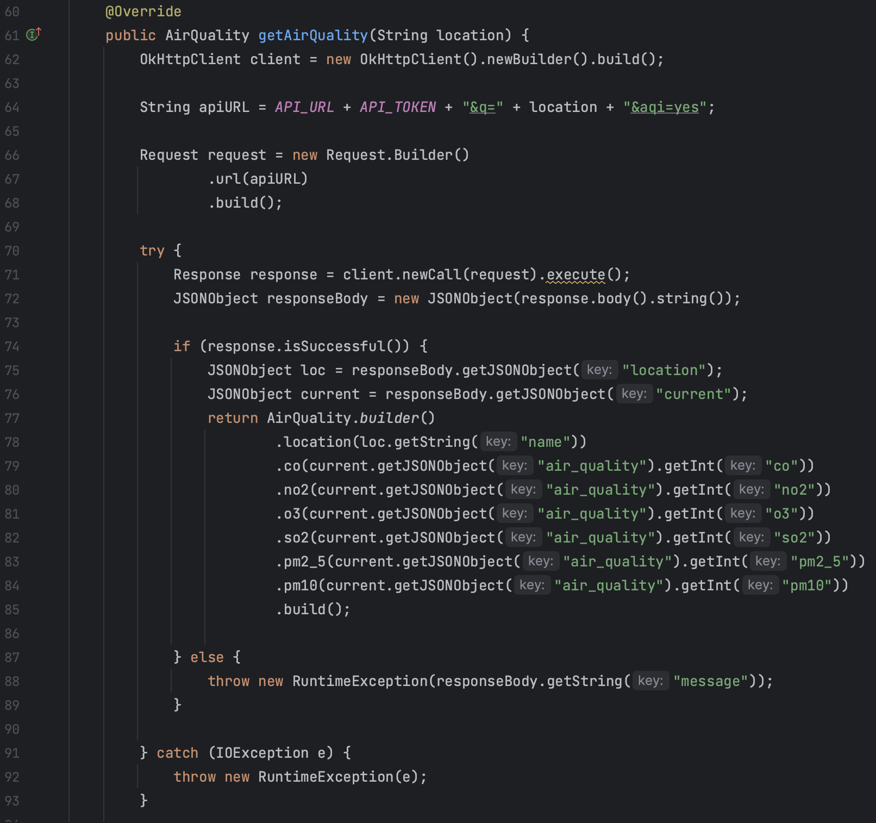

API Endpoint 2 air quality
Description: This endpoint provides detailed air quality data for a specific location.
URL Structure: https://api.weatherapi.com/v1/current.json?key=[API_KEY]&q=[LOCATION]&aqi=yes
Class Involved in our Project: APIDataAccessObject, AirQuality, AirQuality Use Cases, AirQuality Interface Adapters.
Method: getAirQuality(String location)
Functionality: On user request, fetches air quality indices like CO, NO2, O3, SO2, PM2.5, and PM10 levels.

Slide 5





Specification
New User Sign Up (Users will be provided text inputfields for):
Username
Location
Create or Join Group(optional)
User Login
Users provide Username and press the button
Program jumps into logged in view
Get Group
Provide user with all the groups he or she has joined
Display the weather conditions and local time of everyone in each group
Weather
Provide the weather of the location typed in the text inputfield
AirQuality
Get air quality of the location

Slide 6
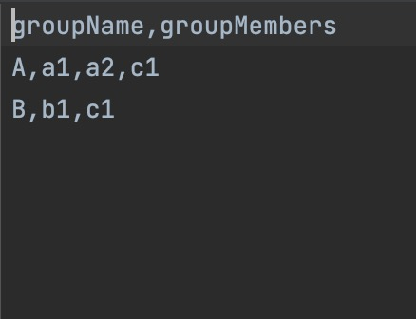
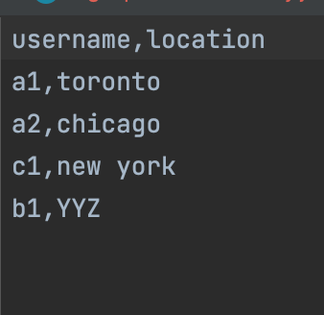
What is in csv files now

Slide 7
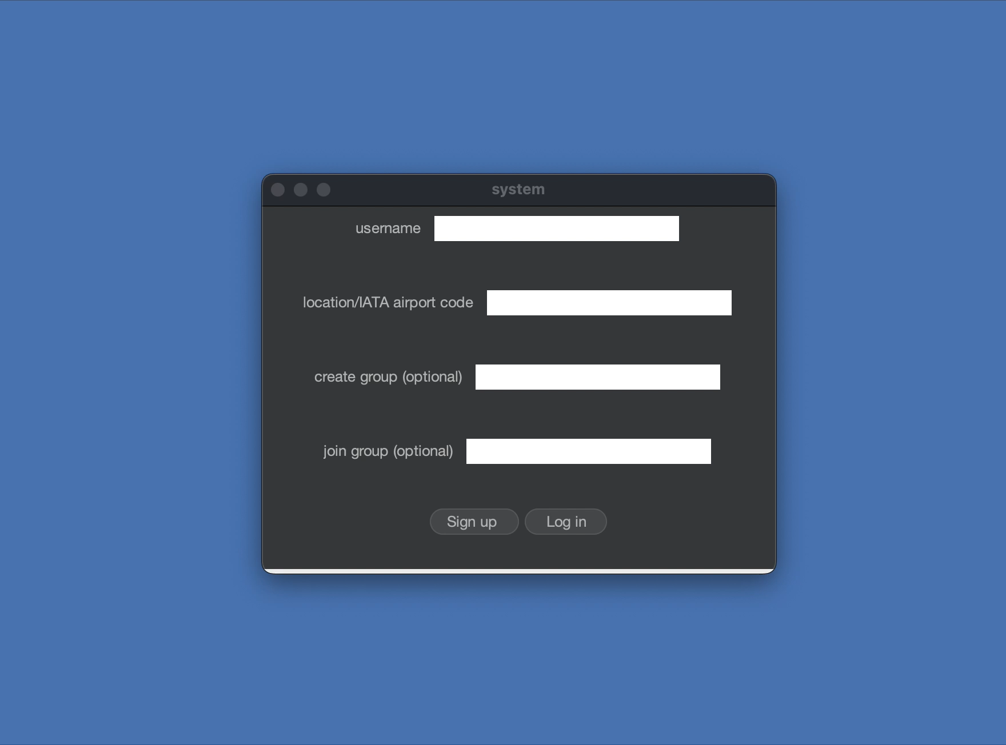
Sign up demo

Slide 8
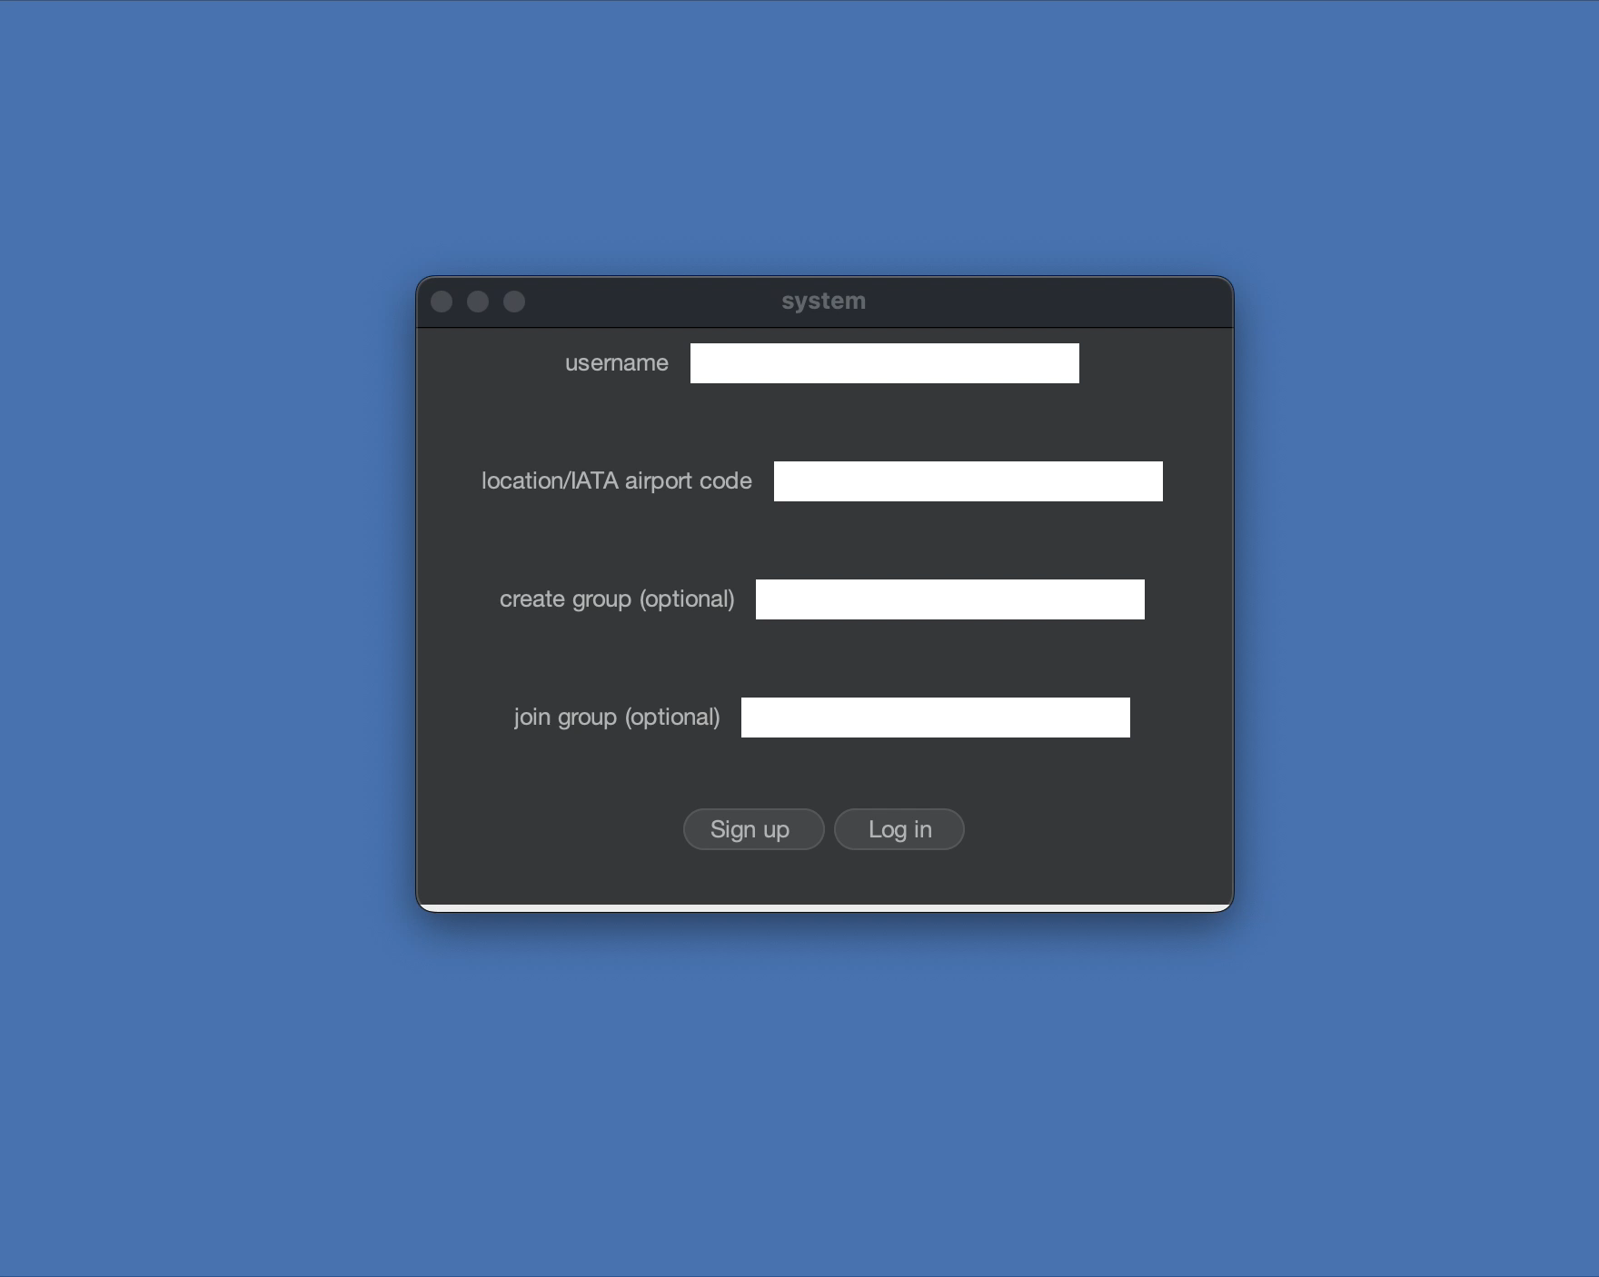
LOG IN demo

Slide 9

Software design

Slide 10

SOLID principles
While we design our program and codes, we followed the principles what we have learnt in this course, by adherence to SOLID principles, our codes are promoted to be more understandable, flexible, and maintainable software design.
Here are the three SOLID Principles we will evaluate further:
Single Responsibility Principle (SRP)
Interface Segregation Principle (ISP)
Dependency Inversion Principle (DIP)

Slide 11
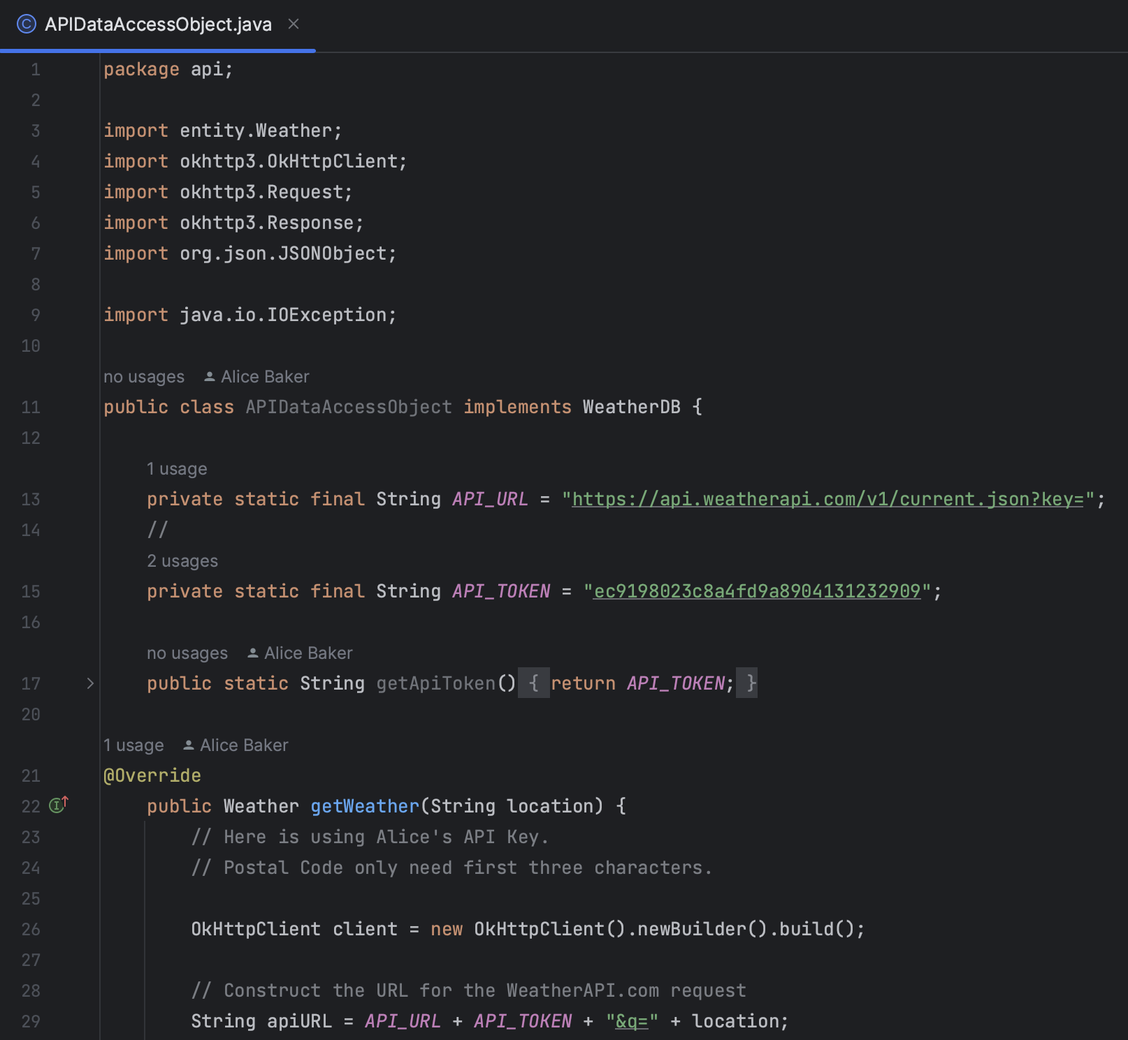
Single Responsibility Principle (SRP)
In our code, one class has only one responsibility, for example, the APIDataAccessObject class that only handles fetching weather data (GET) from the API, while View and other elements are from other classes.
Same as other use cases, each class in the code only process their own responsibility.

Slide 12
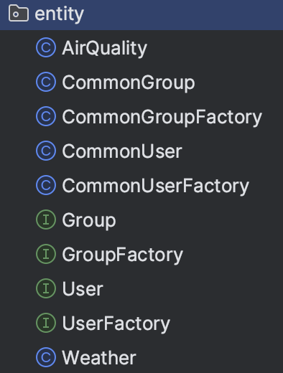
Interface Segregation Principle (ISP)
Specific Interfaces for Different Features: Our application uses different interfaces for distinct functionalities. For example, we have separate interfaces for user management (User), weather data handling (Weather), and group management (Group).
Segregating these interfaces makes the code more modular and easier to update, changes in the group management feature (add a feature called leave group) won't affect the user management part (no need to modify User interface), as they rely on different interfaces.

Slide 13
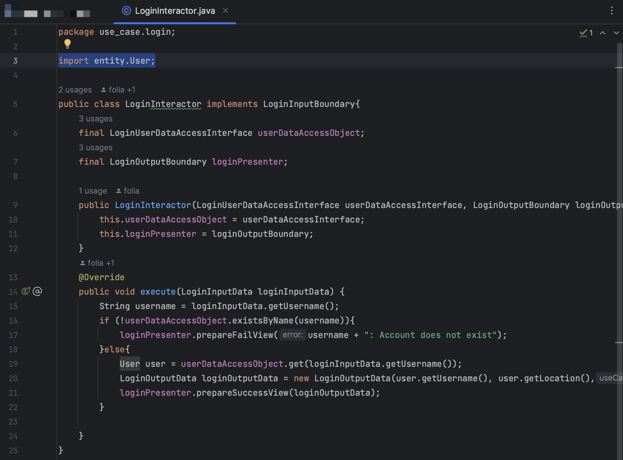
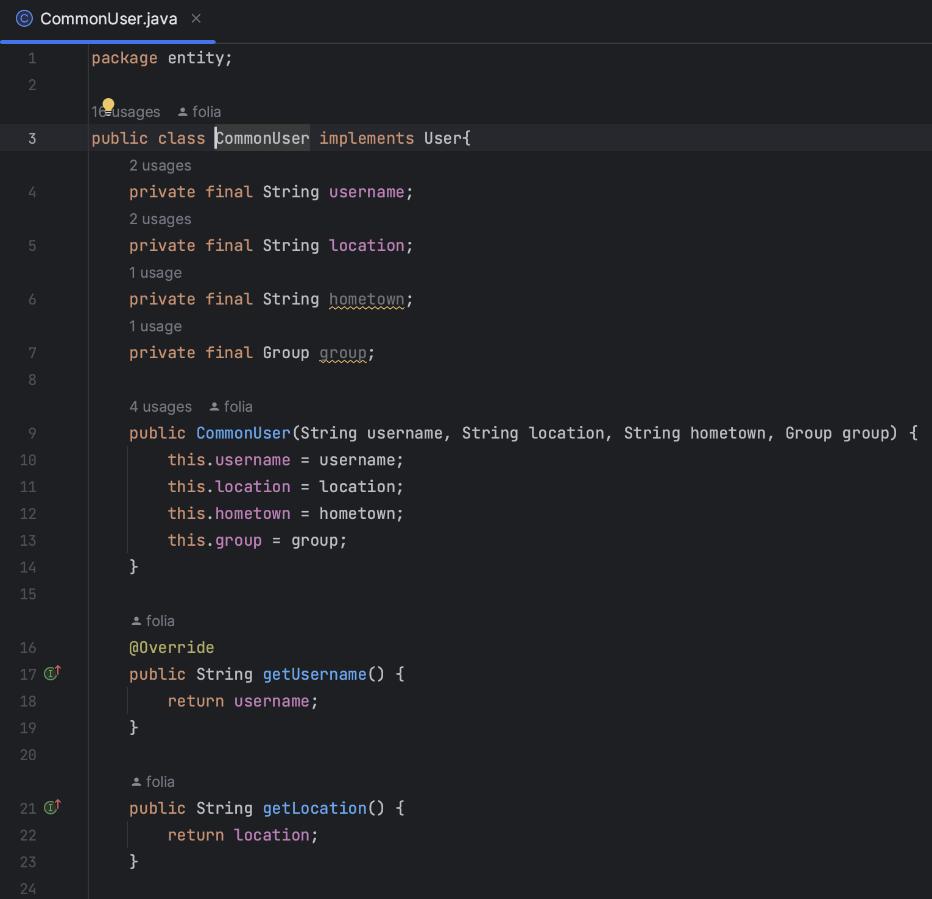
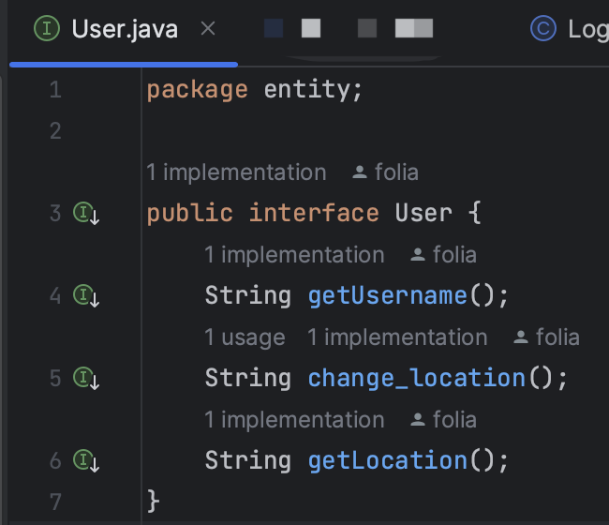
Dependency Inversion Principle (DIP)
Our code is just like the principle says, high-level modules like user interaction handlers depend on abstract interfaces rather than concrete implementations. For example, our LoginInteractor depends on User interface rather than the concrete CommonUser class.
This demonstrates a clear adherence to DIP and makes our application more flexible and testable.

Slide 14
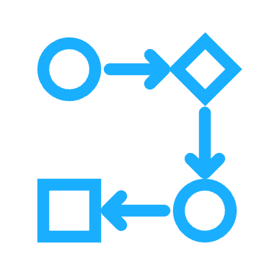
Clean architecture
Clean Architecture is the base of our Project. This is to say, all of our codes are built upon Clean Architecture – strictly following the rules and the Clean Architecture Engine.
Specific CA Applications:
Entities: User, Group, Weather.
Use Cases: Login, Signup, Group, Weather.
Interface Adapters: Login, Signup, Group, Weather.
View: Login, Logged In, Signup
Data Access: UserDAO, GroupDAO, WeatherDAO.
An important thing of Clean Architecture benefit the project is the code will be more modular, easy to maintain, extend and test. As people moves, this provides a chance of newcomers can easily get familiar with the code and working on new features or integrating with different APIs when the old crew left.

Slide 15
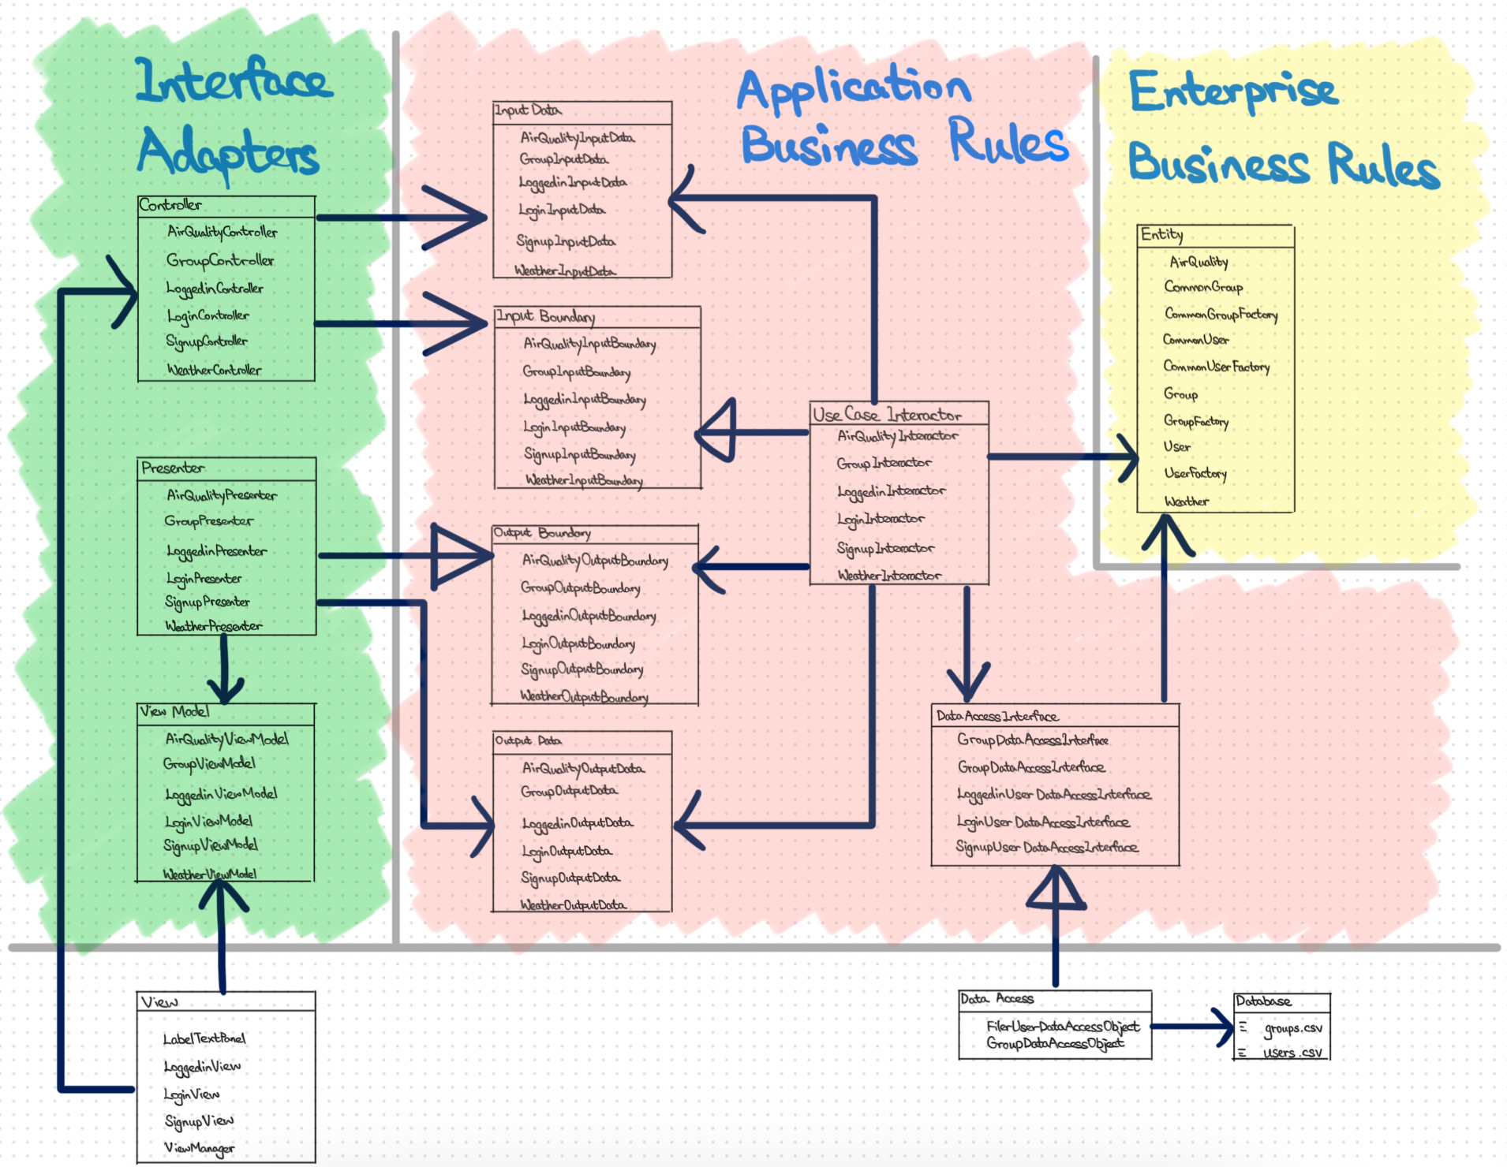
Project Clean architecture diagram
Note: Future Works not included.

Slide 16
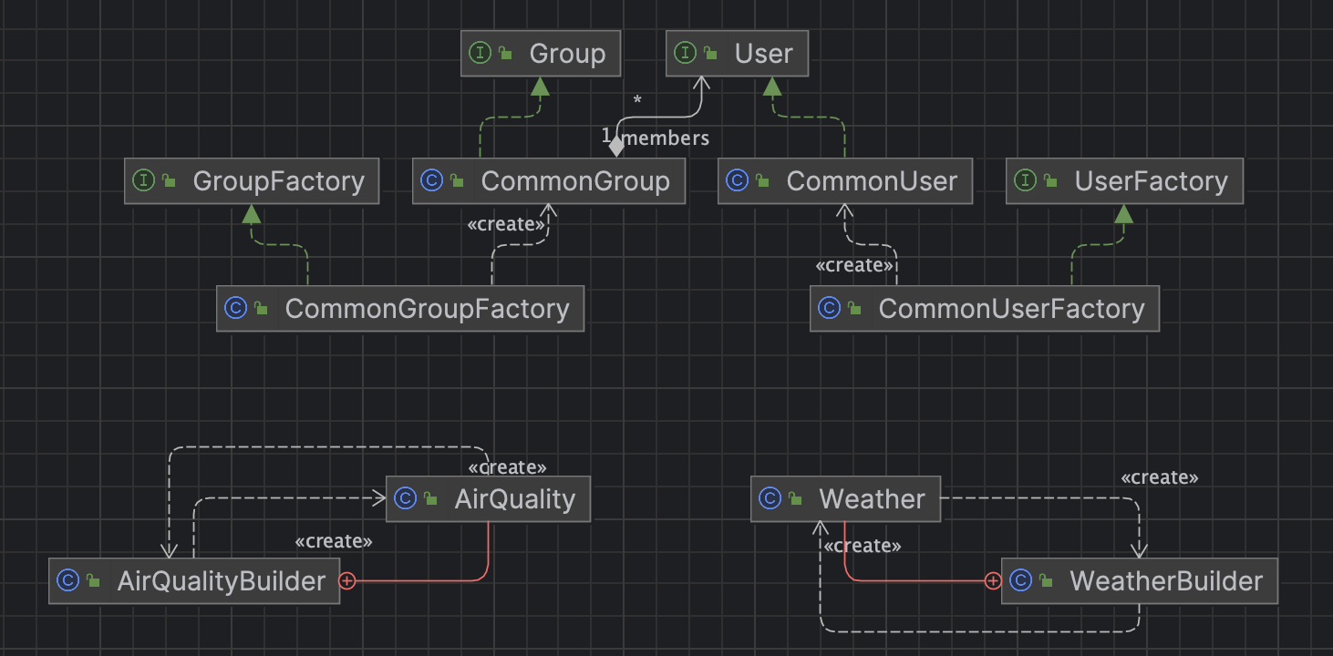
ENtity UML diagram

Slide 17
Evidence of adherence in Dependency Rule
A great example in our project for convincing the adherence of the Dependency Rule in Clean Architecture would be the implementation of APIDataAccessObject.
Inward Dependency: The APIDataAccessObject depends on external APIs (outward element) but provides data inwards to your application's core layers (like use cases or business logic). It doesn't depend on any inward elements, adhering to the Dependency Rule.
Decoupling from Business Logic: The class doesn't contain any business logic; it's solely responsible for data fetching. This separation ensures that business logic in inner layers remains independent of external services.

Slide 18

For Design Patterns, we implemented our codes with:
Observer Pattern
Builder Pattern
We chose these patterns as the Builder Pattern for creating complex objects with ease, while the Observer Pattern for managing updates between your Views and ViewModels efficiently, as we have many use cases for our project.
DESIGN patterns

Slide 19

Observer Pattern
The Observer Pattern involves two key types of objects – Subjects and Observers. The Subject maintains a list of Observers and notifies them of any state changes, usually by calling one of their methods.
Subjects:
SignupViewModel
LoginViewModel
LoggedinViewModel
Observers:
SignupView
LoginView
LoggedinView
This Subject-Observer relationship allows for a low-coupled design where objects can interact without being tightly bound to each other, making the system more flexible and easier to maintain.

Slide 20
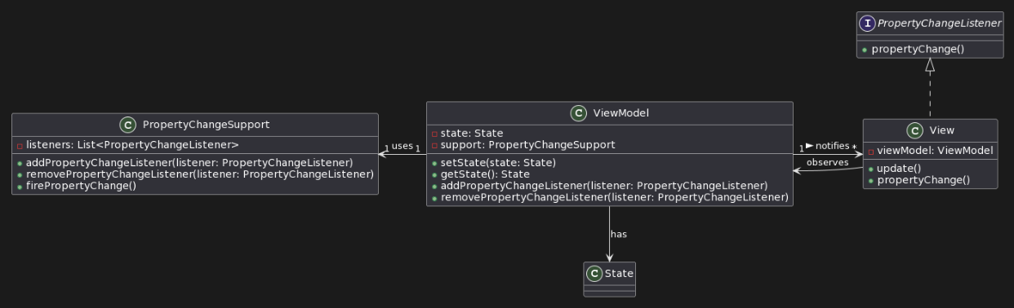
Observer pattern evidence
SignupViewModel: When a new user completes the signup process, this `SignupViewModel` updates its state to reflect the successful registration. All Views observing this `SignupViewModel` (like the `SignupView`) get notified to update their display to redirect the user to loggedinView.
LoginViewModel: Similarly, after a user logs in, the `LoginViewModel` updates its user authentication, which then triggers an update in the `LoginView`, redirecting the user to the `LoggedinView`.
UML Class Diagram showing structural relationship between View and ViewModel.

Slide 21
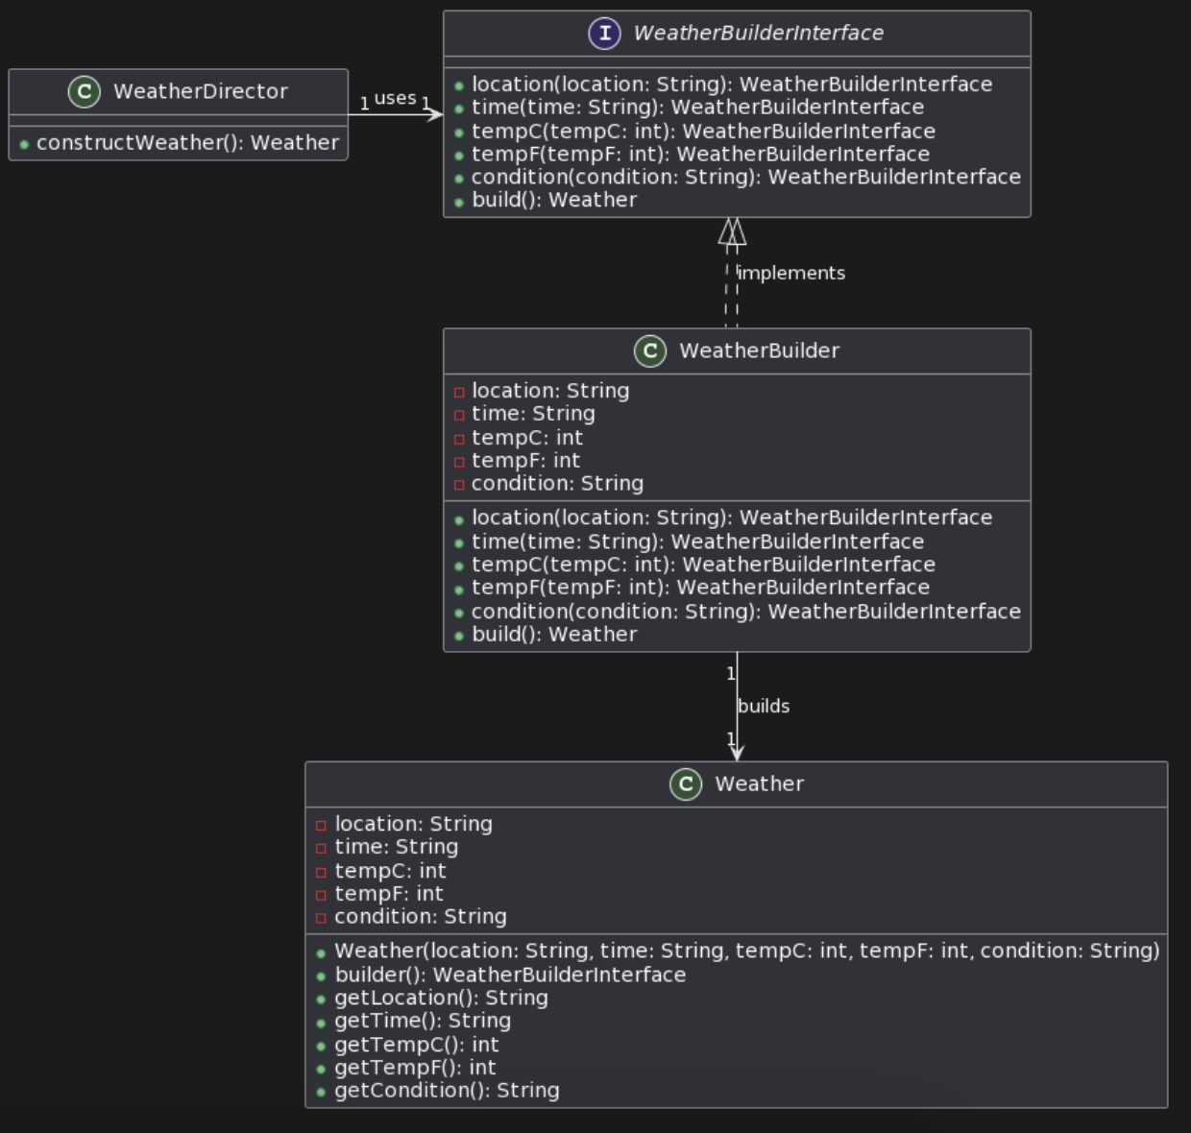
Builder pattern
Complex Object Creation: As the Weather class represents a complex object in our domain model, requiring several properties to be set during its instantiation (like `location`, `time`, `tempC`, `tempF`, `condition`).
Builder Implementation: The nested WeatherBuilder class is implemented within the Weather class to facilitate the step-by-step construction of a Weather object.
Sample UML Class Diagram for Weather and WeatherBuilder

Slide 22





Builder pattern evidence
Class Involvement:
Weather Class: This class acts as the complex object for which the Builder Pattern is implemented.
WeatherBuilder Class: A nested static class within Weather that provides methods to set the properties of Weather and a build method to instantiate the Weather object.
WeatherBuilder Methods:
Fluent Interface: Each method in WeatherBuilder returns the builder instance itself (return this;). This design supports fluent chaining of method calls, making the client code more readable and intuitive.
Clear Purpose: Each method is named after the field it sets (location, time, tempC, tempF, condition), clearly indicating its purpose. This clarity enhances code readability and maintainability.
Default Values and Validation: The Builder Pattern allows for setting default values or adding validation logic within the builder methods. This can ensure that the Weather object is always in a consistent state.

Slide 23

Testing

Slide 24
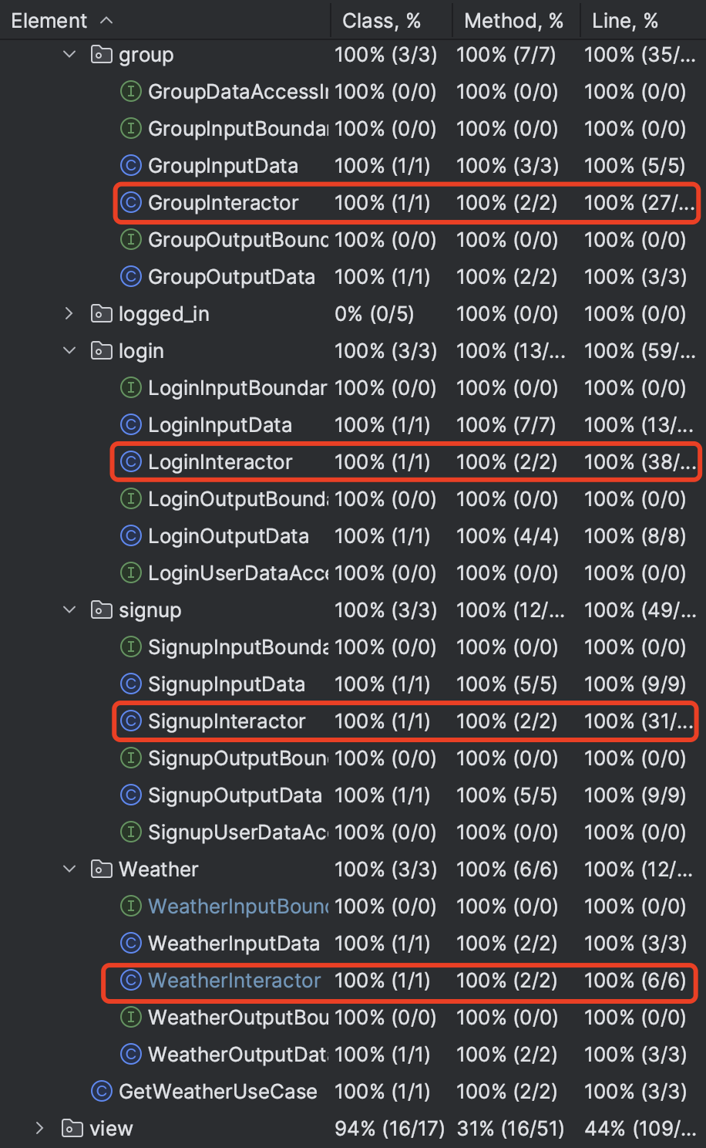
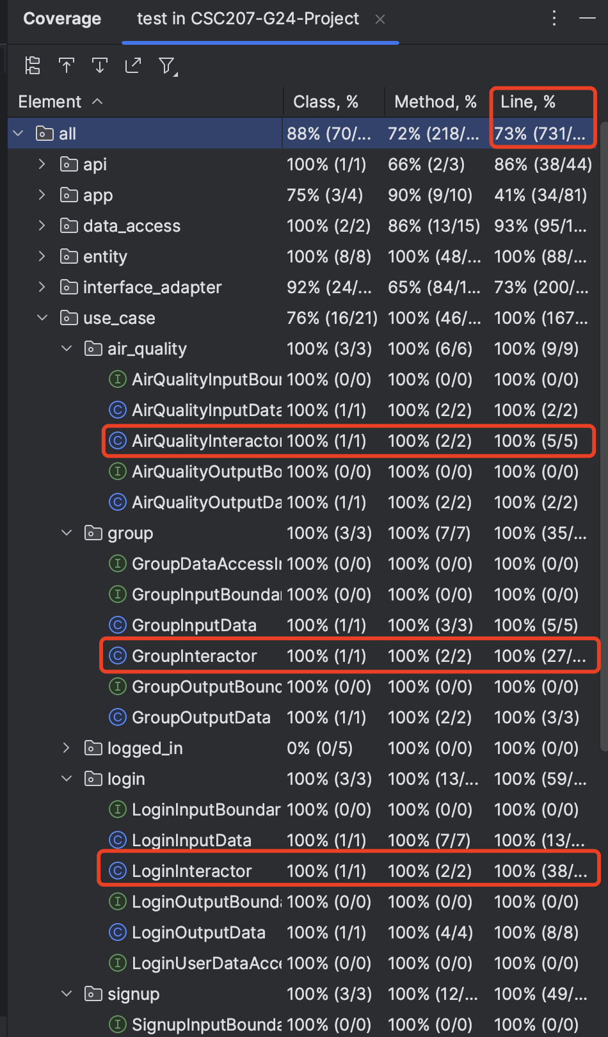
Testing
Focusing on use case interactors, we have made tests to check the functionalities and logics of our codes.
We achieved:
73% Coverage For Code Base
100% Coverage for Interactors
However, we did not do testcases for main.java, this is because full coverage tests of main.java is not practical or necessary.
Instead, we focus on thoroughly testing individual components and their integration, along with a lot of manual GUI testing for View and main.

Slide 25

Code organization

Slide 26
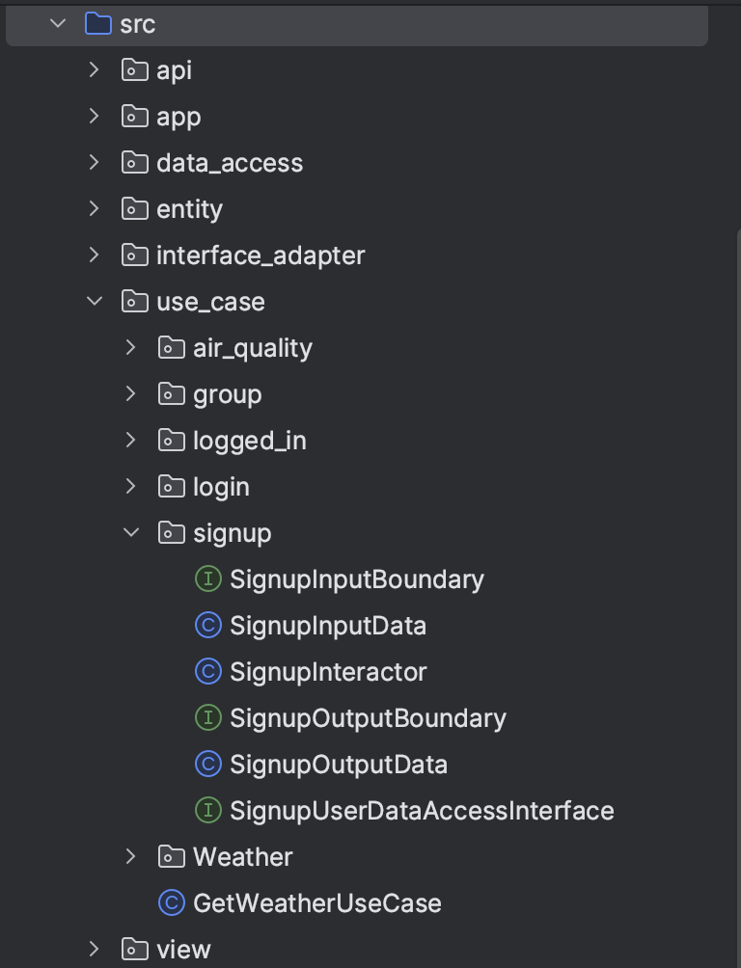
Code organization
As our code is built based on Clean Architecture, we then chose to package our codes by layer of Clean Architecture as well.

Slide 27

Future works
During the implementation of Trip (Create Trip, Edit Trip), we experienced significant difficulties combing it into our project as we have to make more use cases in variant ways (Trip & User, Trip & Group), so we moved all codes of Trip to future works.
The UI/UX Design of our program needs some improvements in the future, to make everything clearer and we would like to make more pages/panels/pop-ups.
Authentication methods needs to be added for User sign up and log in, this will make user data more secured. In addition, Group may also need some authentication methods to join (or make admins).
We created a Label called Future Works under Issues on GitHub for Future Works.

Slide 28
Contribution
Alice Baker:
Sign Up
Logged In
Air Quality
API
Yue Chen:
Group
Domain Design
Test Cases
Yuewen Zhang:
Log In
Weather
Group
Code Connection and Debugging
Zhikang Tian:
Git Organization
Trip
Test Cases
Documentation
Presentation Contents
We would like to show contribution due to a Git problem that might show wrong contribution.

Slide 29
Thank you for your participation
Presented by team24

